Slide 1

Generative Model For Better Internal Ice Layer Thickness Prediction
Zesheng Liu

Slide 2

Background and Motivation
Dataset
Previous work & Current Issue
Project Goal
Problem Statement
Existing Solutions

Slide 3
Background & Motivation

Slide 4
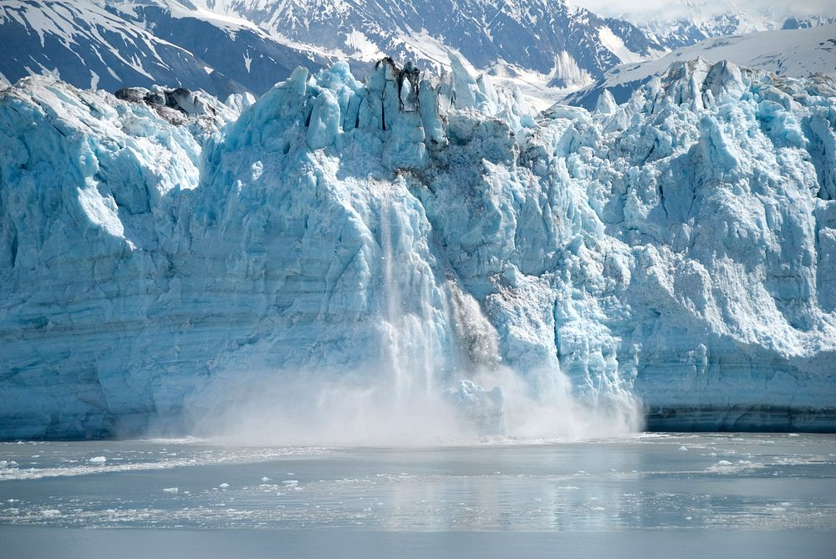
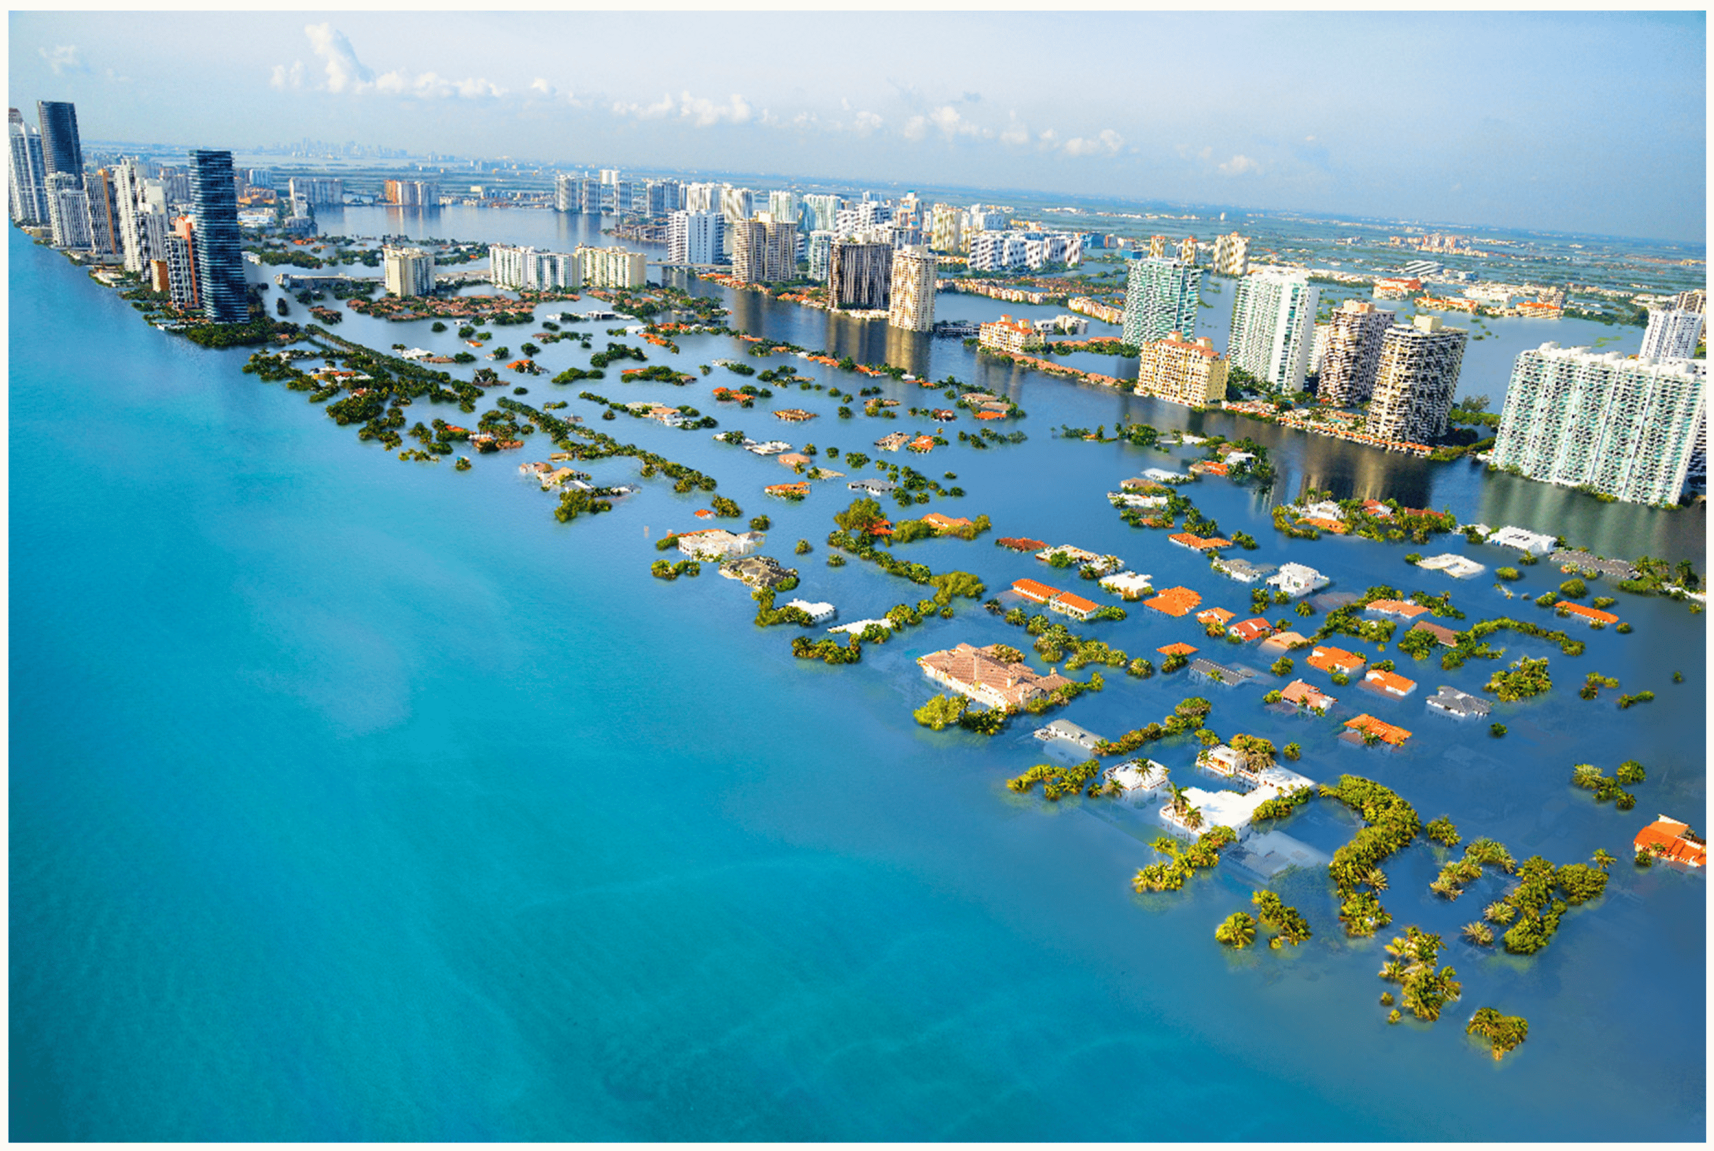
Credit: Left--Ackon @Wikipedia Common, Right—Wood(2019)
Global warming has caused great damage to our environment and society
The loss of polar ice is accelerated
Polar ice holds vital clues about past and present climate , making it key to understand sea level rise and global change.

Slide 5
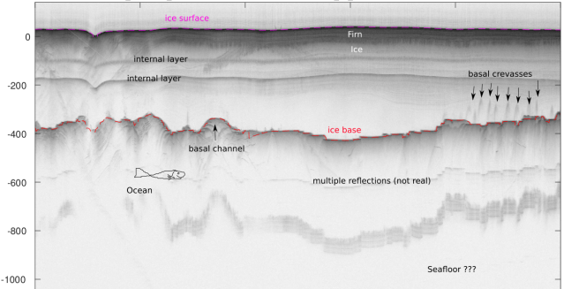
Ice sheets are built from layers of snowfall and compaction, preserving a year-by-year record of Earth’s climate history.
Why is it important to study the internal layers?
Assess snowfall melting and accumulation
Track sea level change and its climate impact
Reduce uncertainties in climate models
Credit: Christian Wild

Slide 6
Dataset

Slide 7
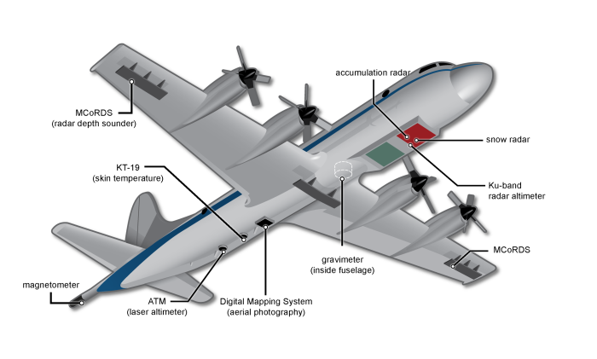
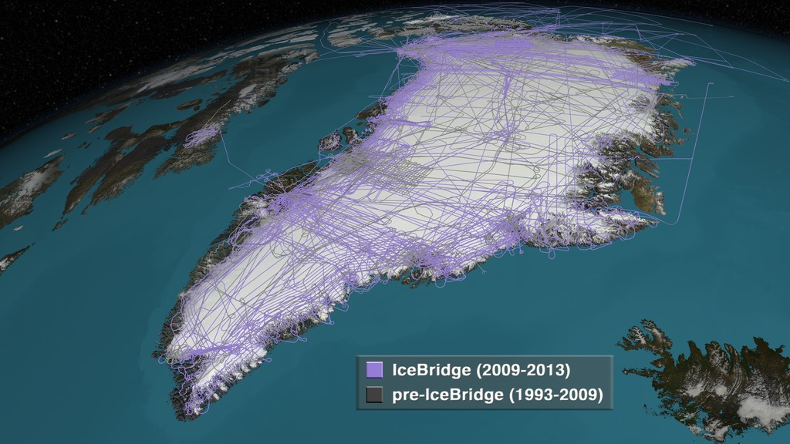
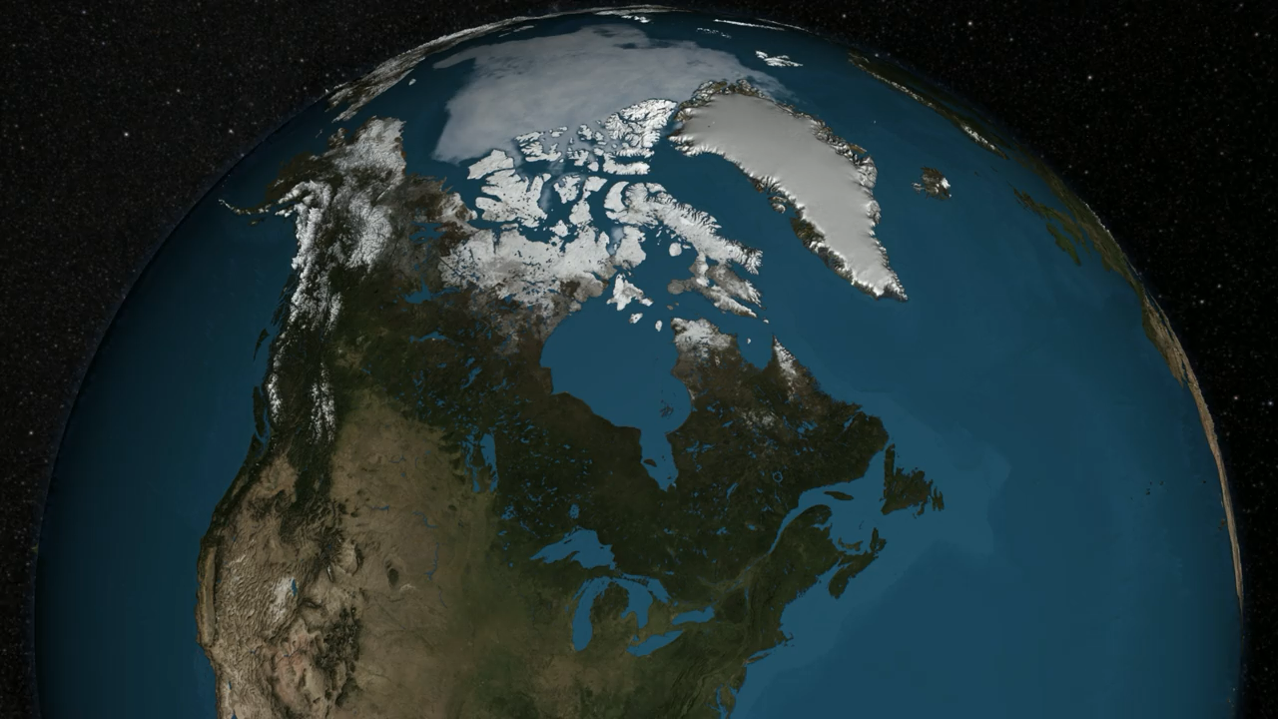


Our dataset is collected by airborne snow radar sensor.
It is the only sensor that can penetrate through the thick ice sheet and is the most effective way to capture internal layers
Figure: NASA Operation IceBridge Mission. (left) The plane that carries the snow radar (right) Flight route across the polar region

Slide 8
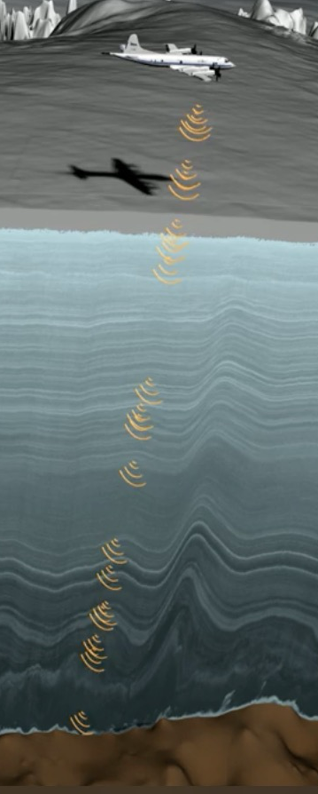
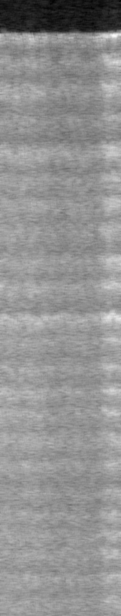
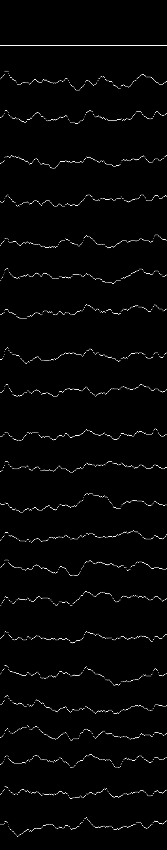

Internal ice layers are captured as radargrams by measuring the strength of reflected signal, where brighter pixels mean stronger reflection
Each radargram has a depth of 1200-1700 pixels, with a fixed width of 256 pixels
Each ice layer is then manually labeled out.
Layer thickness is calculated as the pixel difference between boundaries
Airborne radar sensor captures the status of internal layers
Radargram
Labeled images

Slide 9
Previous Work & Current Issue

Slide 10
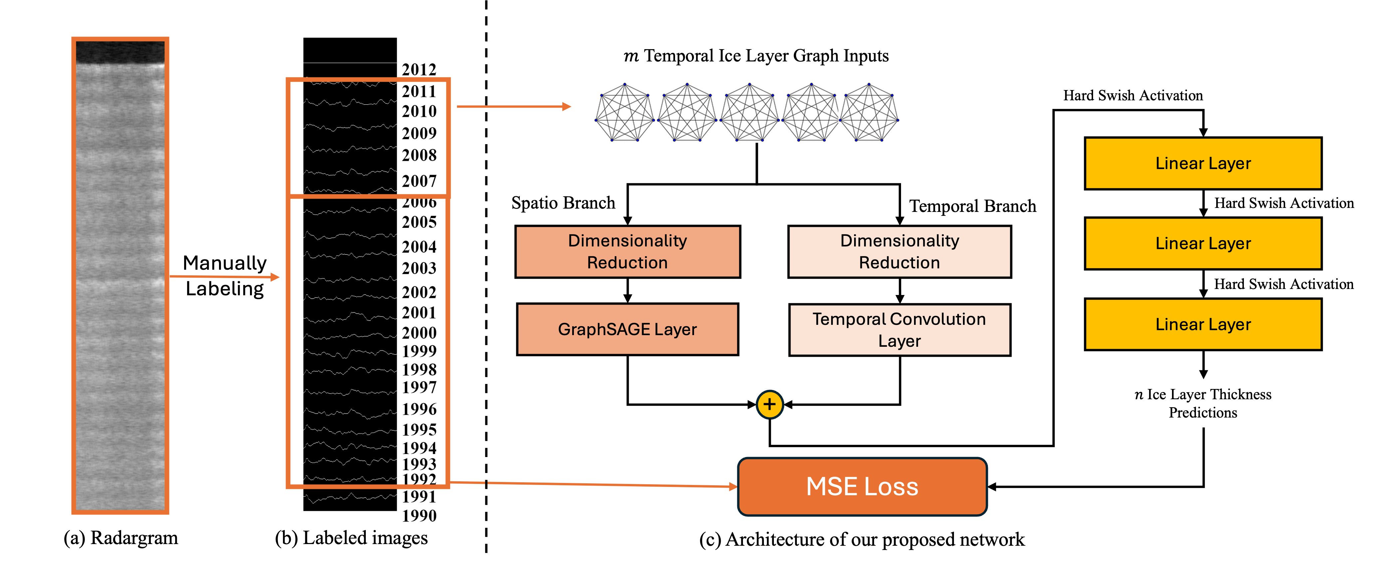
Represent internal ice layer as individual graphs and use graph neural network to learn for geographical and thickness information of the top 5 layers, and predict the underlying 15 layers.

Slide 11
There are some current issue:
1) Ice layers may not be complete:
Some ice layers are incomplete or totally missing due to melting or other physical process.
2) Ice layers varies at different locations:
In certain area, fewer number of layers can be identified.
Typically, radargram data can be divided into L1, L2, L3.
L1 is the test data from central Greenland assumed to be mostly dry snow zone
L2 contains echogram from the transition from Greenland Summit to the NE coast.
L3 contains echogram with poor image quality from NE Greenland coast.
In previous work, we do data filtering by choosing radargrams with at least 20 complete layers. This made us only have 1660 amount of data. Additionally, we cannot evaluate the model performance on different type of data---We have to mix L1, L2, L3 together, otherwise our training data is mainly L1 only!

Slide 12
Goals

Slide 13
The goal of our project is to generate additional training data to make able to evaluate model’s on different type of regions.
First, let’s take a look at a summary of our current dataset.
Dataset | # of data that has 20 complete layers | # of data that has 20 layer but with NaNs | # of data that has less than 20 layers
Train | 1074 | 1122 | 9105
Validation | 94 | 158 | 1071
L1 Test | 124 | 3 | 0
L2 Test | 367 | 345 | 337
L3 Test | 0 | 0 | 116

Slide 14
Problem Statement

Slide 15
We will do two tasks.
Task 1:Filling NaNs in current data files.
Model Input:
X_{masked} : Node feature matrix with some values randomly masked (set to NaN or 0)
Mask: A 0-1 binary matrix, where 1 means the value is observed; 0 means the value is masked.
Radargram image I: The original radargram image
Model Output:
Y: The fully observed matrix without masking
Loss function:
Mean Squared Error Loss
This obviously can be achieved by a generative model

Slide 16
Task 2: Generating additional data files.
Model Input:
Noise vector
Radargram image I: The original radargram image
Model Output:
Synthetic feature matrix
Task 3: Combine two tasks.
Assume we have a feature matrix (256, 15), and some value are NaNs.
First, we can fill in NaNs using the model for task 1.
Then, we can generate five additional layers using current known 15 layers, instead of generating 20 layers.

Slide 17
Exising Solutions

Slide 18
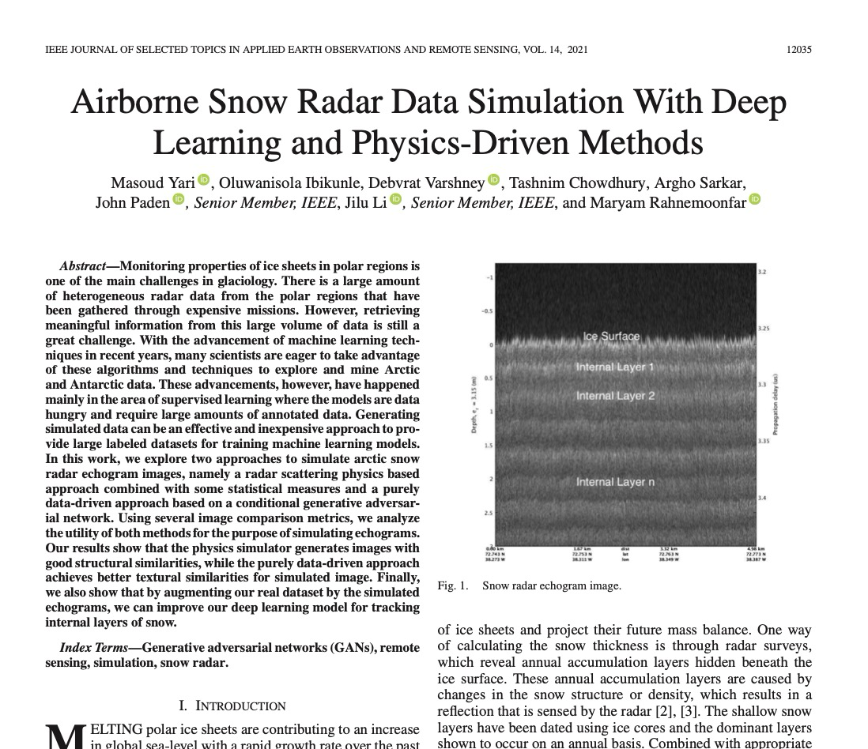
This is a relatively new and domain-specific task, so there is no current solution for an exact same task.
For generative model on radargram, there is one paper:
Airborne Snow Radar Data Simulation With Deep Learning and Physics-Driven Methods

Slide 19
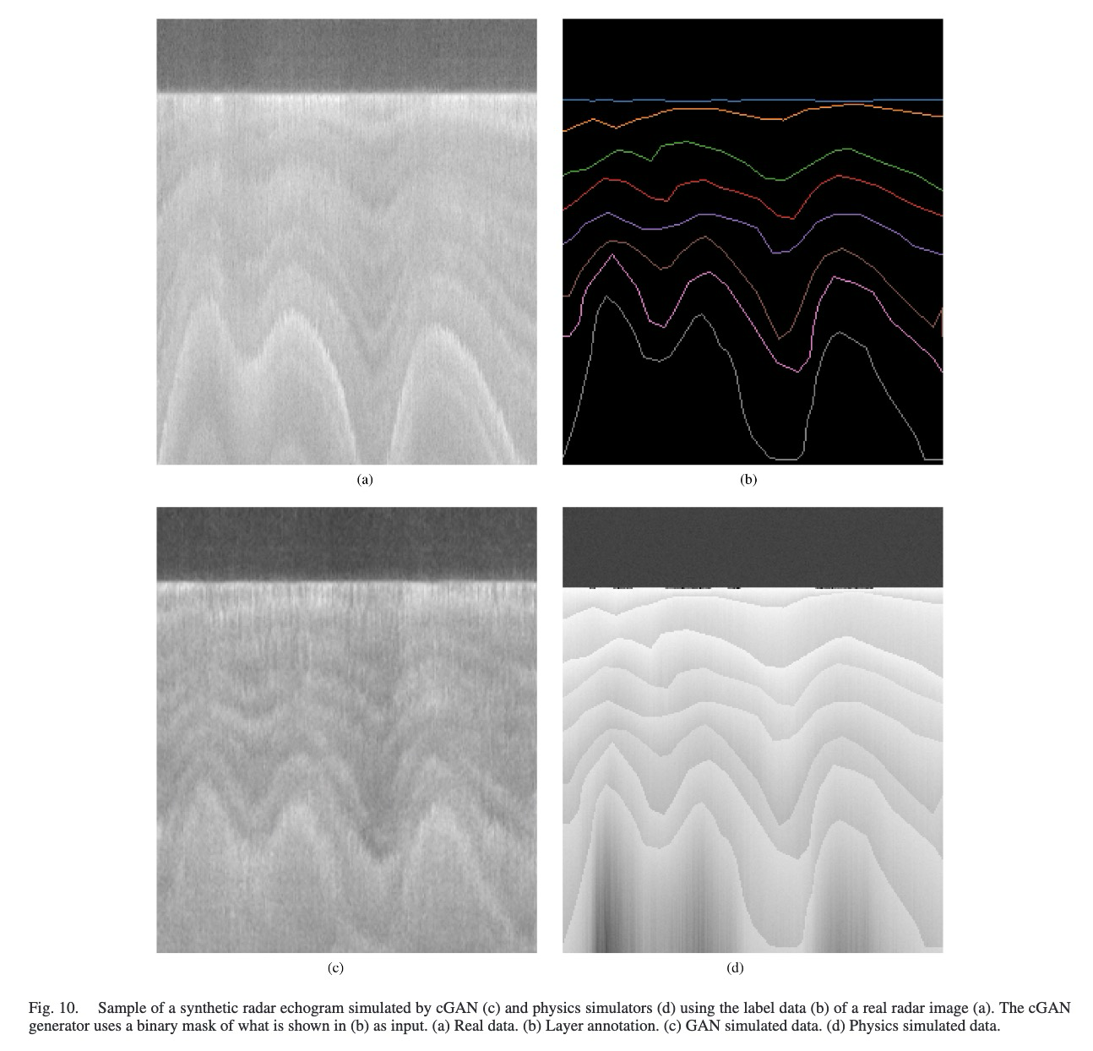
However, their focus is to generative synthetic radargram images instead of layer features(tabular data).

Slide 20
Thank you

